Slide 1
CRO/CDMO Market
Vishvum Sriram – Investor Pitch

Slide 2
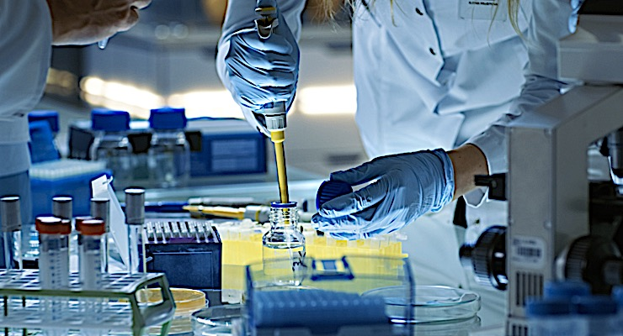
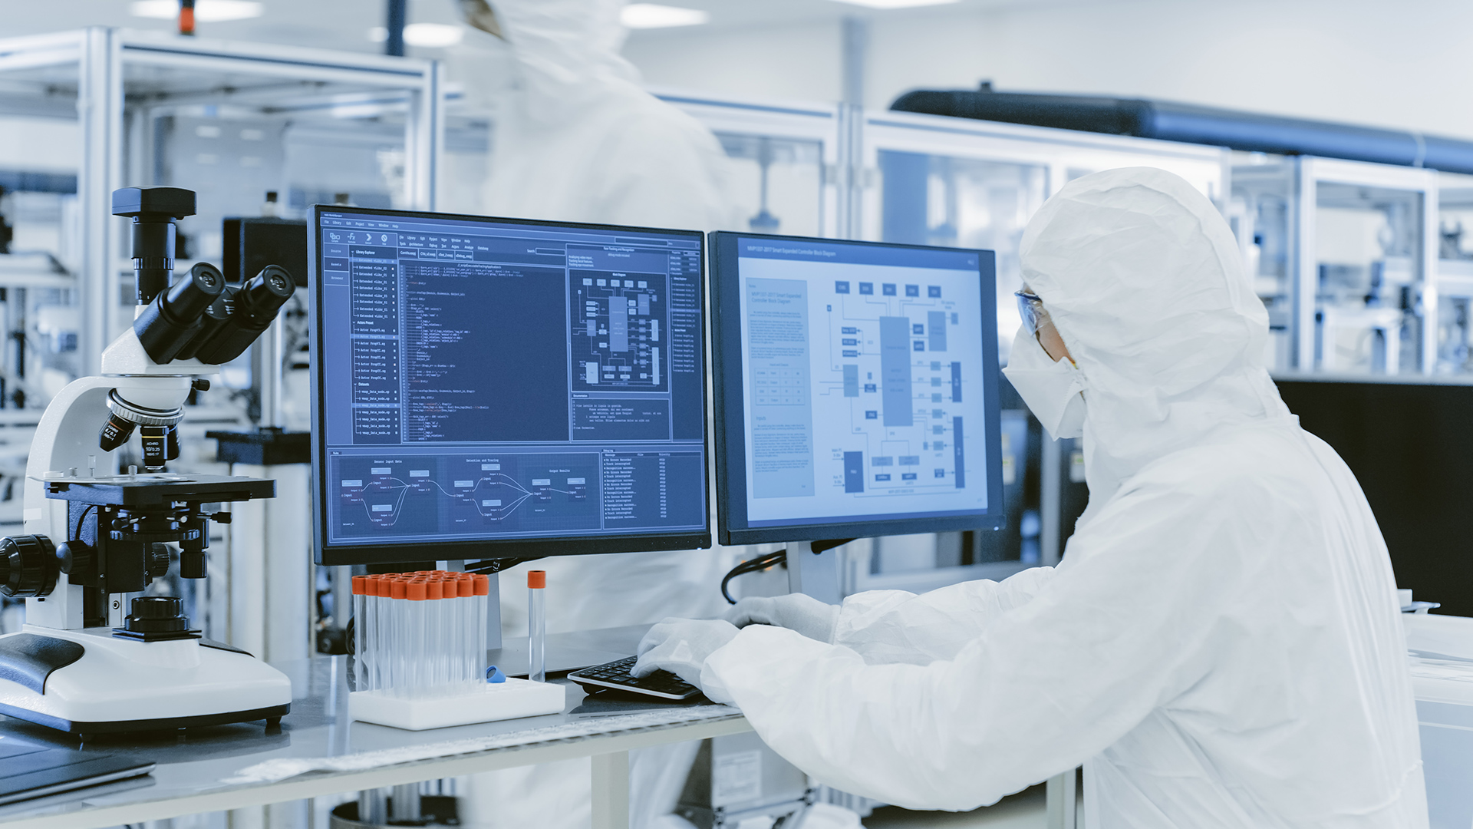
CRO Overview
CDMO Overview
Core Function: Provides outsourced clinical research services, including clinical trials (Phases I–IV), data management, and regulatory support for drug development.
Key Benefit: Reduces costs and accelerates drug development timelines for pharmaceutical and biotech companies.
Market Driver: Rising complexity of clinical trials and increasing demand for specialized therapeutic areas like oncology and rare diseases.
Core Function: Offers comprehensive drug development and manufacturing services, including API production, formulation, and packaging.
Key Benefit: Provides scalability and expertise in biologics, mRNA, and other advanced therapies, reducing capital expenditure for pharma/biotech firms.
Market Driver: Increasing focus on personalized medicine and the growth of biologics and biosimilars.

Slide 3
Market Dynamics & Size
Market Growth
The CRO/CDMO market is a vital component of the pharmaceutical value chain, enabling cost-effective and scalable solutions for drug development and manufacturing amidst increasing global demand.
Valued at $308.9 billion (2022), projected to reach $338.13 billion by 2030, driven by rising R&D outsourcing and biologics demand
Regional Trends
North America dominates due to advanced infrastructure and regulatory stability.
Asia-Pacific is the fastest-growing region, benefiting from cost efficiencies and clinical trial activity.
Therapeutic Focus
Significant growth in biologics, cell & gene therapies, and mRNA, requiring specialized expertise and manufacturing capacity

Slide 4
Key Growth Drivers
This slide outlines major industry tailwinds, market projections, and key statistics demonstrating the robust growth potential in both CRO and CDMO markets.
Pandemic-Driven Expansion
Increasing Demand for Outsourcing
Cost & Efficiency Benefits
COVID-19 accelerated growth in both markets due to the rapid development of vaccines and therapeutics.
The global CDMO market grew by over 12% annually during the pandemic, driven by mRNA vaccine production
CROs: Pharma and biotech companies are outsourcing clinical trials to reduce costs and accelerate timelines.
The clinical trials market is expected to grow at a CAGR of 5.8% from 2023 to 2030.
CDMOs: Rising demand for manufacturing complex therapies like biologics, cell & gene therapies, and mRNA vaccines.
Outsourcing allows pharma/biotech companies to focus on core R&D while leveraging CRO/CDMO expertise.
Companies save up to 30% in operational costs by outsourcing clinical research and manufacturing
12% Annual Growth
5.8% 2023 - 2030
30% Costs Saved

Slide 5
Challenges
This slide explores the critical challenges impacting the CRO/CDMO industry, including regulatory complexities and workforce limitations, that shape operational strategies and investment decisions.
Regulatory Complexities
Stringent FDA and EMA requirements
Evolving global compliance standards
Increased scrutiny on data integrity and quality control
Talent Shortages & Labor Costs
High demand for specialized skills in advanced therapeutics
Competitive job market driving up labor costs
Need for continuous training and development

Slide 6
SWOT Analysis
Strengths
Weaknesses
Stable Demand: Consistent outsourcing needs driven by rising drug development costs and the complexity of modern therapies.
High Barriers to Entry: Advanced expertise, capital requirements, and regulatory compliance create competitive advantages for established players.
Recurring Revenue Models: Long-term contracts with pharmaceutical companies ensure steady revenue streams.
Capital-Intensive Operations: High costs for equipment, facilities, and maintaining compliance standards.
Dependency on Pharma Budgets: Vulnerability to pharmaceutical R&D budget cuts or shifts.
Regulatory Complexity: Managing compliance with global regulatory agencies (FDA, EMA, etc.) is resource-intensive and costly.
Offline
Online
Opportunities
Threats
Emerging Markets: Rapid expansion in Asia-Pacific for clinical trials and manufacturing services due to cost efficiency and growing infrastructure.
Advanced Therapies: Increased demand for biologics, gene/cell therapy, and mRNA manufacturing presents untapped growth potential.
M&A Activity: Consolidation trends create opportunities to acquire niche capabilities and expand market share.
Regulatory Risks: Changing regulations can increase compliance costs or delay operations.
Supply Chain Vulnerabilities: Disruptions in global supply chains for raw materials or specialized components.
Intense Competition: Market consolidation and new entrants with advanced capabilities can erode margins.

Slide 7
Investment Perspective
Investing in the CRO/CDMO sector is recommended due to its projected growth to $338.13 billion by 2030, driven by increasing demand for biologics and advanced therapies, with stable recurring revenue models ensuring long-term profitability.
Strongly Recommended Investment

Slide 8
Sources
https://www.credenceresearch.com/report/pharmaceutical-cro-and-cdmo-market
https://www.grandviewresearch.com/industry-analysis/pharmaceutical-cdmo-market-report
https://www.grandviewresearch.com/industry-analysis/clinical-trial-outsourcing-market
https://www.reportlinker.com/market-report/Pharmaceuticals/105533/Pharmaceutical-CRO-Market
https://www.statista.com/statistics/1234454/global-contract-development-and-manufacturing-market-size/
https://www.ibisworld.com/global/market-research-reports/pharmaceutical-contract-manufacturing-industry/

